Slide 1


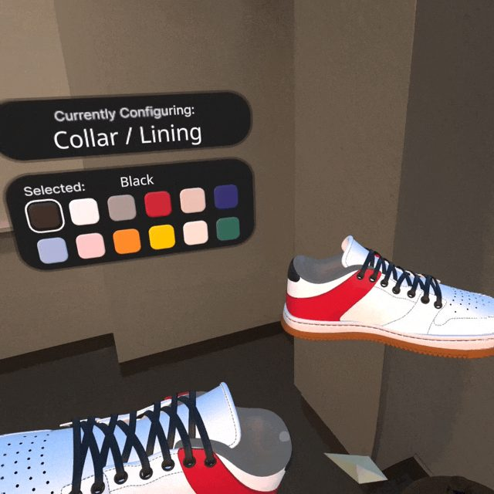

Virtual Reality
WebXR Part 1: how Meta's Sneaker Builder became our Panther Customizer
Wednesdays at 6:00pm
CIST 1423 - 2010 VIRTUAL REALITY PROGRAMMING AND TECHNOLOGY
Try it in a headset: jcallinan.github.io/Alumni-Weekend-2026
Notes:
Repo docs: Meta-WebXR-Samples/README.md, Meta-WebXR-Samples/Sneaker-Builder.md, Alumni-Weekend-2026/panther-builder/FROM-SNEAKER-TO-PANTHER.md.

Slide 2



Agenda
WebXR & Meta's samples
How Sneaker Builder works
Sneaker → Panther
Four showcases and the toolkits behind them
three.js + an ECS, file by file
What we kept, changed, replaced, and deleted
Notes:
Same interaction ideas as SteamVR (rig, grab, ray, UI), with nothing hidden behind an editor.

Slide 3

Today
By the end of class you can…
Explain what WebXR is good for, and name Meta’s four showcases and the toolkits behind them
Tonight's plan
1
Before
Pre-reading: Sneaker-Builder.md + 4 questions
Read Sneaker Builder’s ECS: components are data, systems are logic, order matters
2
40–60
This deck: ECS, scorecard, AR → VR fallback
60–150
Part 2 deck: build WaterWorks
Tell an app’s engine layer from its product layer, using the Sneaker → Panther fork
3
Explain the AR → VR fallback that lets one URL run on a Quest and a Vive Pro 2
4
CIST 1423 — Week 7 — WebXR Part 1: Sneaker Builder → our Panther Customizer
Notes:
Week 7 session plan (with Exam 2 and Part 2): Lesson-Plans/Week-07-WebXR.md. Assign the Part 1 reading in Week 6.

Slide 4
Why WebXR?
VR and MR in the headset's browser. The same ideas as Unity, with every line of the engine visible.
0
1
HTTPS
~1.5k
installs
codebase
required
lines of JS
Ship a URL. Visitors at Alumni Weekend just opened a link
Quest (passthrough MR), SteamVR headsets (VR), laptops (3D viewer)
WebXR only runs on secure origins. The dev server uses a self-signed cert
Sneaker Builder is small enough to read in one sitting
Unity + SteamVR is still our main engine. We read WebXR to see the same concepts built by hand.
CIST 1423 — Week 7 — WebXR Part 1: Sneaker Builder → our Panther Customizer
Notes:
The panther-builder URL worked on Quest Browser in MR and on the Vive Pros in VR, from the same build.

Slide 5
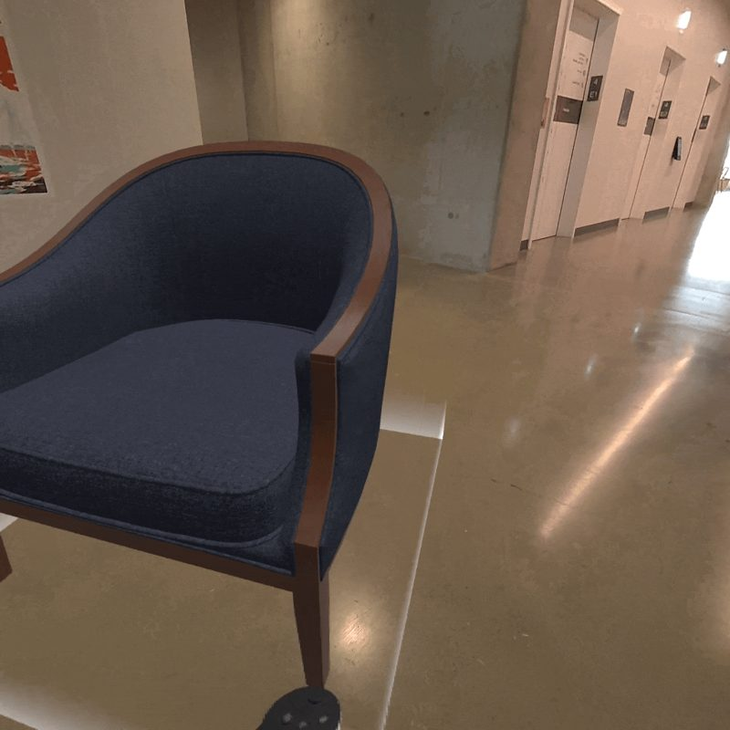
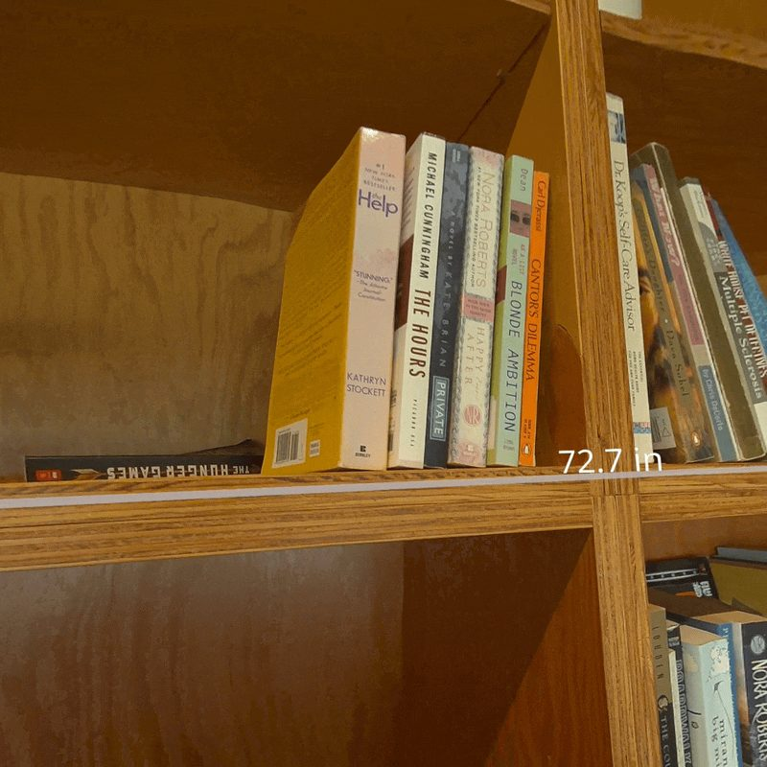
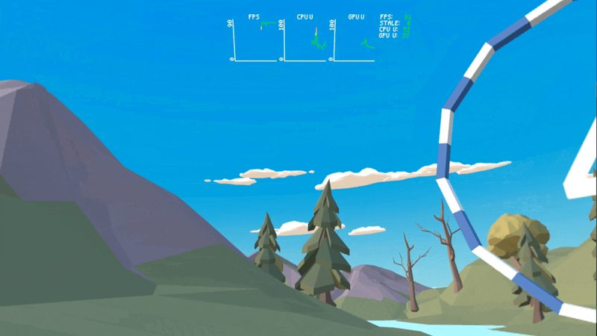
Meta's WebXR Showcases
github.com/meta-quest/webxr-showcases (MIT). All four share one stack: three.js + elics ECS + ratk.
Sneaker Builder
Chairs Etc.
RealMeasure
Flap Frenzy
MR shopping
MR shopping
MR utility
VR game
Grab, hold + point to customize, set down to size
Place furniture on real floors: plane detection, hit-test, Rapier physics
A controller tape measure, anchored in your room
Flap your arms to fly: body movement as input
CIST 1423 — Week 7 — WebXR Part 1: Sneaker Builder → our Panther Customizer
Notes:
Reading order: Sneaker Builder (whole pattern), Flap Frenzy src/flap.js (gameplay from raw controller positions), Chairs Etc. furniture.js + marker.js (scene understanding), RealMeasure for fun. Live demos at meta-quest.github.io/webxr-showcases/<name>.

Slide 6



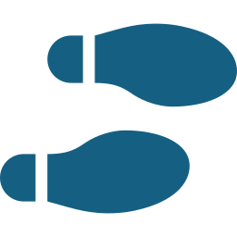
The toolkits behind them
Learn how it works from a showcase, then build faster with the SDK.
Reality Accelerator Toolkit (ratk)
Immersive Web Emulator
Planes, meshes, anchors, and hit-test as three.js objects
ARButton / VRButton helpers
Used by every showcase and by panther-builder
Chrome extension: an emulated Quest + controllers in DevTools
Test without a headset, like SteamVR's 2D fallback
Immersive Web SDK (IWSDK)
webxr-first-steps
Meta's full framework: three.js + ECS with grab, locomotion, spatial UI, Havok physics
npm create @iwsdk@latest · iwsdk.dev
Meta's beginner tutorial project
Do this first if you have never written three.js
CIST 1423 — Week 7 — WebXR Part 1: Sneaker Builder → our Panther Customizer
Notes:
Repos: github.com/meta-quest/reality-accelerator-toolkit, github.com/facebook/immersive-web-sdk, github.com/meta-quest/webxr-first-steps.

Slide 7
Sneaker Builder's stack, in Unity terms
Every package has a Unity analogy you already know.
Package | Role | Unity analogy
three (super-three 0.165) | Renders the scene and runs the WebXR session through renderer.xr | The engine
elics | Tiny Entity-Component-System library | GameObject + MonoBehaviour, split into data and logic
ratk | Enter AR/VR buttons, MR features (planes, anchors, hit-test) | XR Plug-in Mgmt + AR Foundation
gamepad-wrapper | Edge detection + haptics on the raw WebXR Gamepad | SteamVR Input actions
troika-three-text | Crisp SDF text in 3D | TextMeshPro
three-mesh-bvh | Fast raycasts on high-poly meshes | Physics.Raycast
howler | Spatial audio | AudioSource, spatialBlend = 1
webpack (HTTPS dev server) | Bundles src/ → dist/ | Build Settings
@gltf-transform | Draco mesh + KTX2 texture compression (content/compress.mjs) | Texture/mesh import settings
CIST 1423 — Week 7 — WebXR Part 1: Sneaker Builder → our Panther Customizer
Notes:
panther-builder's package.json has exactly the same dependency versions as upstream.

Slide 8


The architecture: ECS in 60 seconds
Components are data, systems are logic, and registration order is execution order.
const world = new World();
world
.registerComponent(GlobalComponent) // + 4 more
.registerSystem(PlayerSystem) // 1st: read controllers
.registerSystem(WelcomeSystem)
.registerSystem(SizingSystem)
.registerSystem(InlineSystem) // desktop mode
.registerSystem(ConfigUISystem) // may switch to ray...
.registerSystem(GrabSystem)
.registerSystem(FollowSystem)
.registerSystem(AudioSystem)
.registerSystem(PointerSystem); // ...last: draw it
renderer.setAnimationLoop(() => { // ≈ Update()
world.update(clock.getDelta(), clock.elapsedTime);
renderer.render(scene, camera);
});
Queries, not references
A system asks for "every entity with a GrabComponent"
Systems never call each other, so you can delete one cleanly
Order matters
PlayerSystem first: everyone sees the same "just pressed" flags
Unity needs Script Execution Order for this
CIST 1423 — Week 7 — WebXR Part 1: Sneaker Builder → our Panther Customizer
Notes:
From sneaker-builder/src/index.js.

Slide 9


player.js: controllers → a clean input model
Unchanged in panther-builder. It is the engine layer.
For each controller
Trick: see your real controllers
renderer.xr.getController(i) → target-ray space (where you point from)
renderer.xr.getControllerGrip(i) → grip space (where your hand is)
selectstart / selectend → isSelecting; every frame derives justStartedSelecting and justStoppedSelecting (≈ GetStateDown / GetStateUp)
A Raycaster aimed down the target ray, shared by every system
Head pose from frame.getViewerPose(), stored on player.head for UI to follow
Controller models get a shader that outputs vec4(0,0,0,0)
They write depth but are transparent, so they cut a hole in the virtual scene and passthrough shows your real hands
// edge detection, once per frame
c.justStartedSelecting = c.isSelecting && !c._prevSelecting;
c.justStoppedSelecting = !c.isSelecting && c._prevSelecting;
c._prevSelecting = c.isSelecting;
CIST 1423 — Week 7 — WebXR Part 1: Sneaker Builder → our Panther Customizer
Notes:
The mask shader is maskMaterial in player.js.

Slide 10



The product layer: grab, customize, size
One hand holds, the other points. Set the shoe down to check your size.
grab.js
configUI.js + sneaker.js
size.js
Nearest grabbable to a free controller
Hand-tuned box around the shoe, in the shoe's local space
Grab: controller.attach(shoe). Release: scene.attach(shoe). Keeps the world transform, like SetParent(p, true)
While a shoe is held, the free hand becomes a ray
Ray a part (12 named meshes) → select it, click + haptic
Ray a swatch → copy color/roughness/metalness onto that part
Prefabs: default, mcdonalds, panda, stone
Drop below 0.5 m → it glides to the floor and faces you
Ray the top/bottom of the sizing panel (uv.y) for ± half a size
US size → length in cm → scale the shoe
Sound as an event: create an entity with a SoundEffectComponent. AudioSystem plays it in 3D, then destroys it.
CIST 1423 — Week 7 — WebXR Part 1: Sneaker Builder → our Panther Customizer
Notes:
Details in Meta-WebXR-Samples/Sneaker-Builder.md section 3.

Slide 11

Sneaker → Panther: the scorecard
Upstream sneaker-builder/src compared line by line with panther-builder/src.
5
5
3
2
unchanged
modified
replaced
deleted
player, follow, pointer, audio, global
index, scene, grab, welcome, landing
constants · sneaker → panther · size → pantherSize
configUI, sizeLayout
The lesson
You don't need to understand a codebase completely before you reshape it. You need to know which parts are the engine (input, pointer, UI follow, audio, loading) and which parts are the product. Every untouched file is engine. Every change is product.
CIST 1423 — Week 7 — WebXR Part 1: Sneaker Builder → our Panther Customizer
Notes:
Dependencies in package.json are identical to upstream as well.

Slide 12
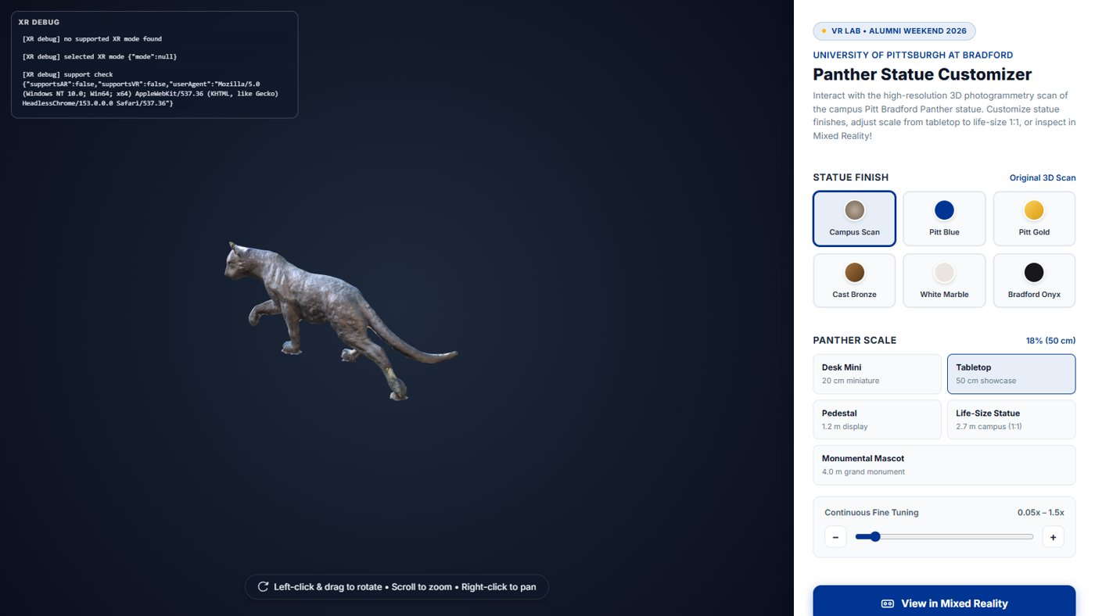
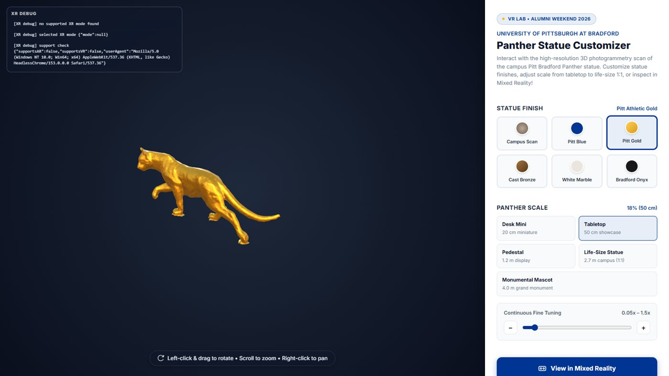
The Panther Customizer, running
Desktop mode in Chrome (no headset attached), before and after picking a finish.
Original scan finish at tabletop size. The XR debug log (top left) reports that no XR device was found, so the 3D viewer is the fallback.
One click on Pitt Gold: panther.setFinish() rebuilds a MeshStandardMaterial (metalness 0.85).
CIST 1423 — Week 7 — WebXR Part 1: Sneaker Builder → our Panther Customizer
Notes:
Screenshots: Alumni-Weekend-2026/panther-builder/docs.

Slide 13
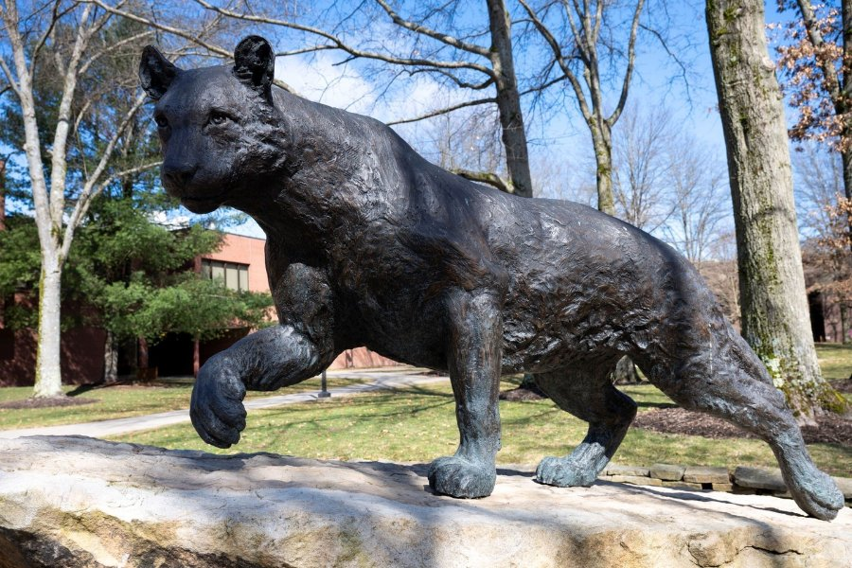

A scanned statue is not a product model
panther.js replaces sneaker.js, and grab.js has to follow.
panther.js
// sneaker-builder: fixed box
localVec3.x > 0.02 - 0.18 &&
localVec3.x < 0.02 + 0.18 && ...
// panther-builder: grows with
// the statue (20 cm → 4 m).
// The root is always scale 1,
// so read the real scale:
const objScale =
global.panther.currentScale;
const grabThreshold =
Math.max(0.4, objScale * 0.8);
if (dist < grabThreshold) { ... }
One mesh, one baked texture: no parts to recolor
Normalize the pivot: center X/Z, base at Y = 0
Finishes: rebuild a MeshStandardMaterial from PANTHER_FINISHES (Royal Blue #003594, Gold #FFB81C, Bronze, Marble, Onyx) or restore the scan
Scale the inner mesh, not the root, so UI on the root stays readable
The bronze Panther → Scaniverse → panther.glb (13 MB)
CIST 1423 — Week 7 — WebXR Part 1: Sneaker Builder → our Panther Customizer
Notes:
The rename also fixed an upstream typo: .attahced → .attached in the skip-held-objects filter. userData.shoeId = "panther" is a deliberate shim so grab.js keeps working.

Slide 14


One URL, two kinds of headset: AR → VR fallback
Upstream required plane/mesh detection and anchors, which only the Quest Browser grants. The lab Vive Pros can only do VR.
// landing.js: ask before binding the button
const ar = await navigator.xr.isSessionSupported('immersive-ar');
const vr = await navigator.xr.isSessionSupported('immersive-vr');
if (ar) ARButton.convertToARButton(btn, renderer, {
requiredFeatures: [], // were required upstream
optionalFeatures: ['hit-test', 'local-floor', ...] });
else if (vr) VRButton.convertToVRButton(btn, renderer, {
ENTER_XR_TEXT: 'Enter VR Experience' });
Debugging in a headset
No DevTools in the headset, so logXRDebug() prints the last 12 XR events into an on-page panel
Feature-detect vendor extensions: updateTargetFrameRate(72) is a Quest Browser extension, now guarded + try/catch
Result: Quest → passthrough MR · Vive Pro via SteamVR → VR · laptop → 3D viewer with the HTML finish/size panel
CIST 1423 — Week 7 — WebXR Part 1: Sneaker Builder → our Panther Customizer
Notes:
welcome.js was also changed to dock the real grabbable statue (not a copy) under the welcome card, and only while in XR.

Slide 15
What didn't make the cut: your exercises
Each gap has most of its answer sitting in upstream sneaker-builder.
Gap | Where | Idea
No in-headset finish picker (HTML panel hides in XR) | configUI.js was deleted | Port it back: hold the statue, ray a 6-swatch panel
No in-headset resizing | pantherSize.js: empty controller loop | Ray the top/bottom of the size panel, like size.js
README promises "trigger to place". No hit-test placement | landing.js requests hit-test, nothing uses it | ratk HitTestTarget reticle, place on trigger
Label stays "Tabletop (50 cm)" after using the slider | setScaleValue() keeps _currentScaleIndex | Track a "custom" scale and show the %
Sneaker leftovers ship (ogimage.png is a shoe!) | src/assets/ | Delete, or reuse for the picker
Full list with file pointers: Alumni-Weekend-2026/panther-builder/FROM-SNEAKER-TO-PANTHER.md
CIST 1423 — Week 7 — WebXR Part 1: Sneaker Builder → our Panther Customizer
Notes:
Good candidates for a WebXR mini-project or extra credit.

Slide 16

Same ideas, two toolchains
Idea | WebXR showcases | Unity + SteamVR
Game loop | setAnimationLoop → world.update() | Update()
Rig | xr.getController / getControllerGrip | Player prefab, Hand
Just pressed | isSelecting && !_prevSelecting | GetStateDown
Grab | controller.attach / scene.attach | Hand.AttachObject
Haptics | getHapticActuator(0).pulse(0.1, 50) | TriggerHapticPulse
Deploy | npm run build → GitHub Pages | Windows .exe
# run the Panther Customizer
cd Alumni-Weekend-2026/panther-builder
npm install
npm test # 3 tests
npm run serve
# https://localhost:8081
# headset: https://<PC-IP>:8081
Read next
Meta-WebXR-Samples/Sneaker-Builder.md
panther-builder/FROM-SNEAKER-TO-PANTHER.md
CIST 1423 — Week 7 — WebXR Part 1: Sneaker Builder → our Panther Customizer
Notes:
Accept the self-signed certificate once. WebXR requires HTTPS.

Slide 17
Check your understanding
Answer with a partner first, then we'll compare.
Q1
Q2
Which system runs first in Sneaker Builder, and why does that matter?
How does Sneaker Builder play a sound, the ECS way?
Q3
Q4
Name two files panther-builder left unchanged, and why that was safe.
Why did the Vive Pro 2 need a code change to enter the Panther app?
CIST 1423 — Week 7 — WebXR Part 1: Sneaker Builder → our Panther Customizer
Notes:
Answers:
Q1. Which system runs first in Sneaker Builder, and why does that matter?
PlayerSystem: every later system sees the same "just pressed" flags that frame.
Q2. How does Sneaker Builder play a sound, the ECS way?
Create an entity with a SoundEffectComponent; AudioSystem plays it at the right 3D position and destroys it.
Q3. Name two files panther-builder left unchanged, and why that was safe.
Any of player, follow, pointer, audio, global: they are engine code that never mentions sneakers.
Q4. Why did the Vive Pro 2 need a code change to enter the Panther app?
Upstream required AR features only the Quest Browser grants; it now falls back to immersive-vr.

Slide 18

Next steps: homework + planning
Run Sneaker Builder locally (or in the Immersive Web Emulator) and answer the 4 reading questions
Read FROM-SNEAKER-TO-PANTHER.md and pick one exercise
Stretch: fork panther-builder with your own scanned campus object, then list the files you didn't touch
Part 2 (this week): we fork it again into WaterWorks, a multiplayer water-system builder
CIST 1423 — Week 7 — WebXR Part 1: Sneaker Builder → our Panther Customizer
Notes:
Reading questions are at the end of Meta-WebXR-Samples/Sneaker-Builder.md.

